Slide 1
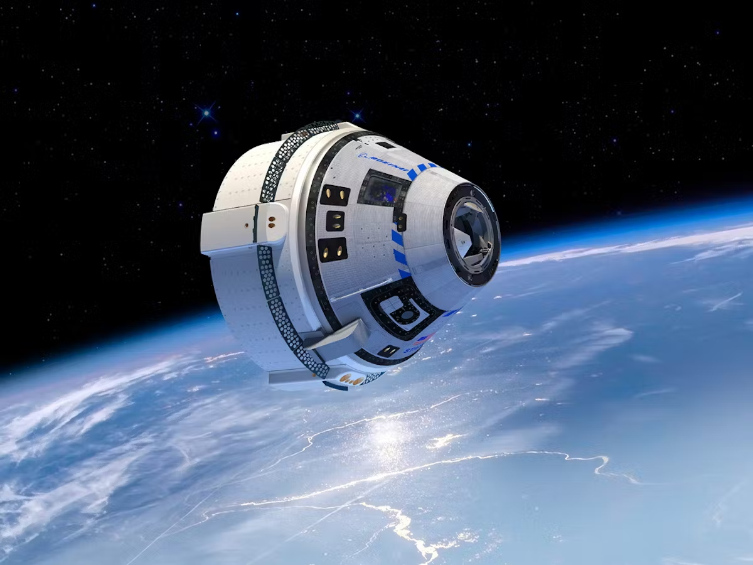

Conference Project:
Investigating the cause of faults in the Boeing Starliner’s spacecraft and its consequences.
(Starliner (no date) Boeing Future of Flight. Available at: https://www.boeingfutureofflight.com/starliner (Accessed: 25 November 2024)).

Slide 2
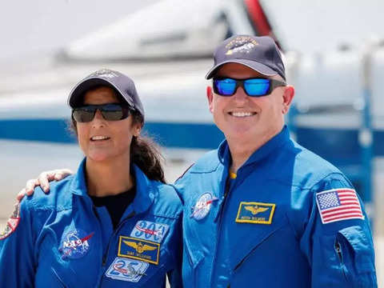

The Starliner Incident
on the 5th of June 2024, NASA astronauts Barry "Butch" Wilmore and Sunita "Suni" Williams experienced faults from their capsule during their 10 day crew flight test for the Boeing Starliner. A spacecraft funded by NASA to help pave the way into commercialised space travel. Helium began to leak from launch and there was widespread thruster failures. The astronuats did end up arriving safely but the capsule was ejected back to Earth and they are set to wait 6 months until a Space X crew ship can pick them up.

Slide 3
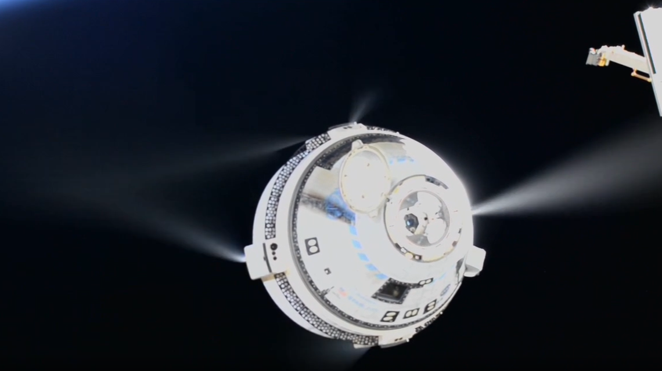
Thrusters
After testing on an identical engine in New Mexico, made for a future model. It was found almost all of the thrusters behaved poorly, with the cause finally being located as a Teflon seal that expanded under the high heats and pressures thrusters go under. Thrusters work by accelerating propellant gas through a control nozzle to propel spacecraft through a vacuum. Blockages would then lead to limited movement or even internal pressure building to dangerous levels.

Slide 4
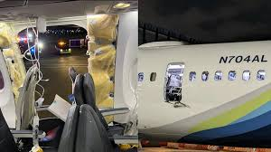
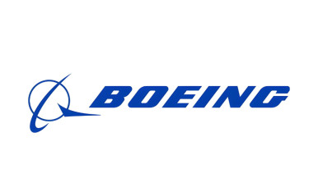
Boeing
Boeing has been in the news multiple times in the last decade due to accidents and malfunctions caused by problems in their engineering projects, such as 2 737 Max 9s having fatal crashes and more recently a emergency door blowing out mid air on an alaskan airline flight without prompt. Boeing’s rush to make deadlines and poor budget spendings allowed many flaws to slip through their engineering safety tests. If There is not a notable improvement in quality monitoring for their products it is likely they will lose their contract with NASAs CCP as well as various other aerospace companies.

Slide 5
Thank You For Watching!

